Slide 1
Are Uranus and Neptune Responsible for Solar Grand Minima and Solar Cycle Modulation?
Arxiv.org (Cornell University) 2010 pre print
International Journal of Astronomy & Astrophysics 2013

Slide 2
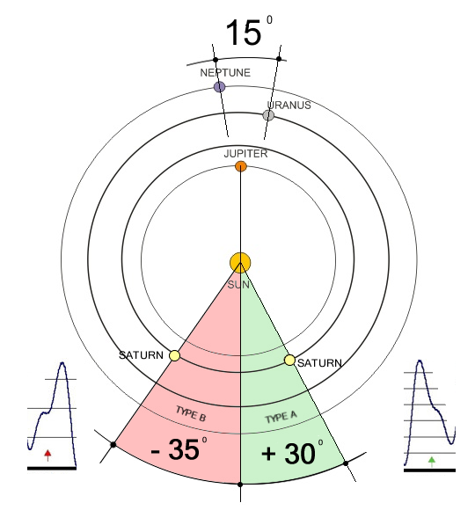
Prime Planetary Position to Initiate the Largest Disordered Orbit.
This position is the ONLY combination that can produce a disordered inner loop orbit.
The Saturn position of +30 to +40 degrees to the perpendicular being the strongest, which is seen at 1472 in the middle of the Little Ice Age (LIA).
The 1472 position returns on a 4627 year cycle NOT the 178.8 year cycle as suggested by Jose.

Slide 3
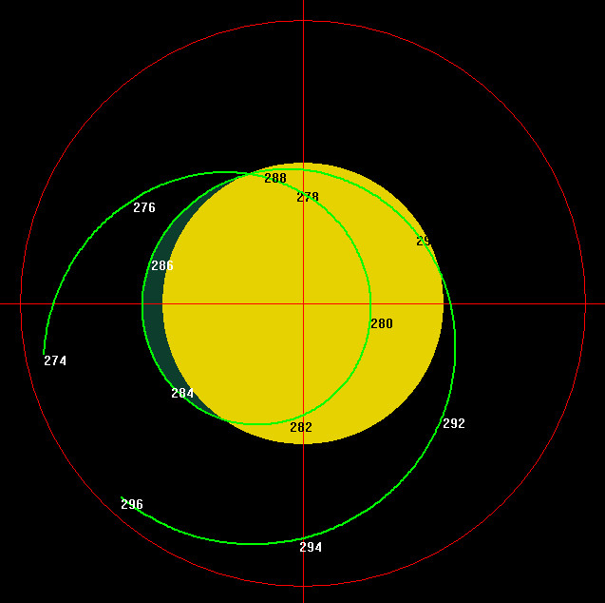
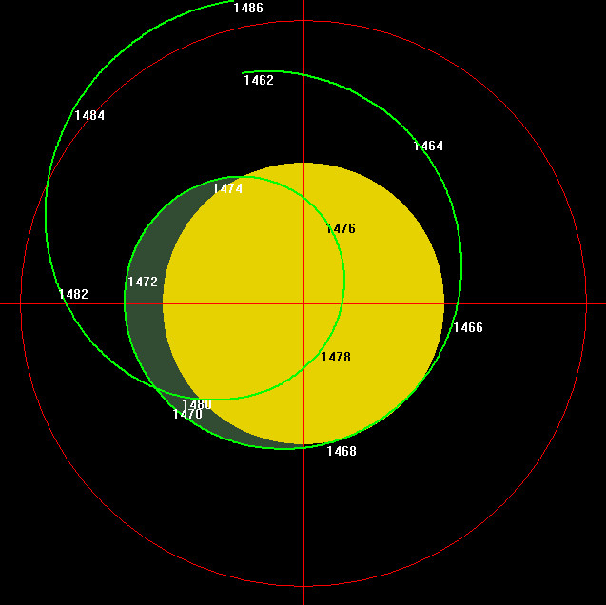
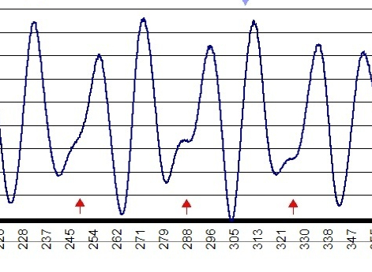
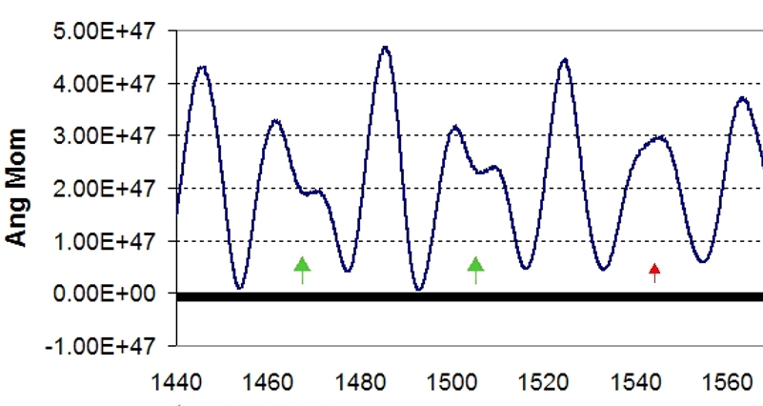

Slide 5
Type A & B AMP Events
286AD
1472AD

Slide 6
Are Uranus and Neptune Responsible for Solar Grand Minima and Solar Cycle Modulation?
Arxiv.org (Cornell University) 2010 pre print
International Journal of Astronomy & Astrophysics 2013
More information at www.landscheidt.info

